Slide 1


Slide 2
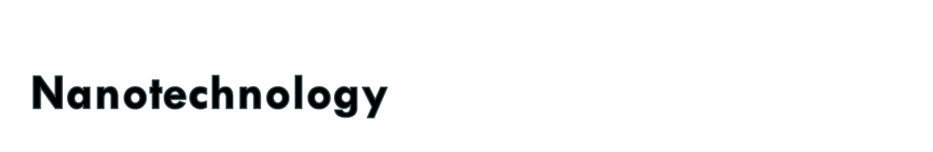
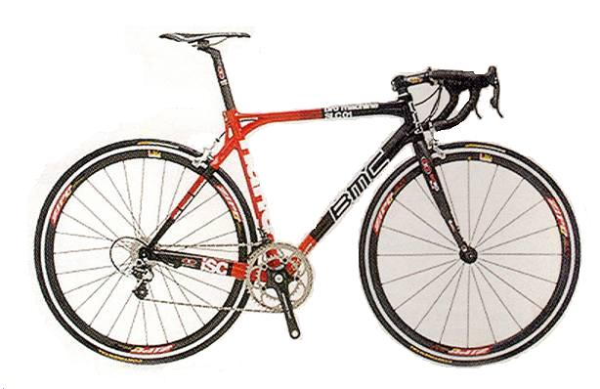
is already making today’s products:
  Lighter
  Stronger
  Faster
  Smaller
  More Durable

Slide 3

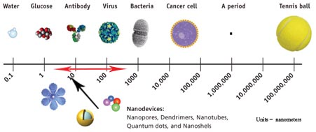
Units in nanometers (µm)

Slide 4

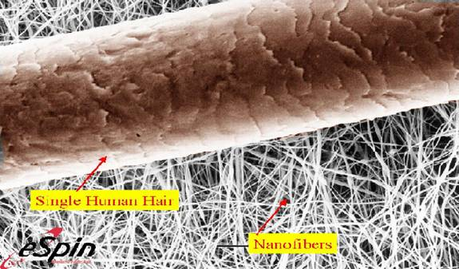
A Human Hair is about 100,000 µm wide

Slide 5

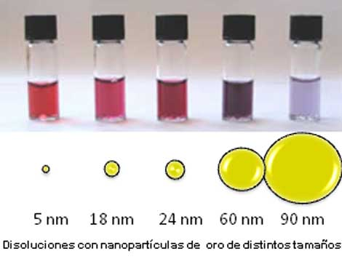
Nanomaterials are an increasingly important product of nanotechnologies. Nanotechnologies make use of very small objects or artefacts. They contain nanoparticles, smaller than 100 nanometres in at least one dimension.
Nanomaterials are coming into use in healthcare, electronics, cosmetics and other areas. Their physical and chemical properties often differ from those of bulk materials

Slide 6
Engineered nanomaterials are resources designed at the molecular (nanometre) level to take advantage of their small size and novel properties which are generally not seen in their conventional, bulk counterparts.
The two main reasons why materials at the nano scale can have different properties are increased relative surface area and new quantum effects.
Relative surface area
Quantum effects
These property can change or enhance property such as reactivity, strength, electric and magnetic behaviour

Slide 7

As the size of particle decreases greater proportion of atom are found at the surface for e.g.
Size 30 nm- 5% of atom on its surface
Size 10 nm- 20% of atom on its surface
Size 3 nm- 50% of atom on its surface
To understand the effect of particle size on surface area, consider an American Silver Eagle coin. This silver dollar contains 31 grams of coin silver and has a total surface area of approximately 3000 square millimeters. If the same amount of coin silver were divided into nanoparticles – say 10 nanometer in diameter – the total surface area of those particles would be 7000 square meters (which is equal to the size of a soccer field

Slide 8

Nanomaterials have a much greater surface area to volume ratio than their conventional forms, which can lead to greater chemical reactivity and affect their strength.

Slide 9

The so-called quantum size effect describes the physics of electron properties in solids with great reductions in particle size. This effect does not come into play by going from macro to micro dimensions. However, it becomes dominant when the nanometer size range is reached.
Quantum effects can begin to dominate the behavior of matter at the nanoscale - particularly at the lower end (single digit and low tens of nanometers) - The causes of these drastic changes stem from the weird world of quantum physics.

Slide 10

The bulk properties of any material are merely the average of all the quantum forces affecting all the atoms that make up the material. As you make things smaller and smaller, you eventually reach a point where the averaging no longer works and you have to deal with the specific behavior of individual atoms or molecules - behavior that can be very different to when these atoms are aggregated into a bulk material.

Slide 11
Materials reduced to the nanoscale can suddenly show very different properties compared to what they show on a macroscale. For instance, opaque substances become transparent (copper); inert materials become catalysts (platinum); stable materials turn combustible (aluminum); solids turn into liquids at room temperature (gold); insulators become conductors (silicon).

Slide 12
The quantum confinement effect can be observed once the diameter of particle is of the same magnitude as the wavelength of electron
Quantum confinement effect is responsible for increase of energy gap between energy state and band gap.
When particles are small there electric optical and magnetic properties differ significantly from bulk materials

Slide 13

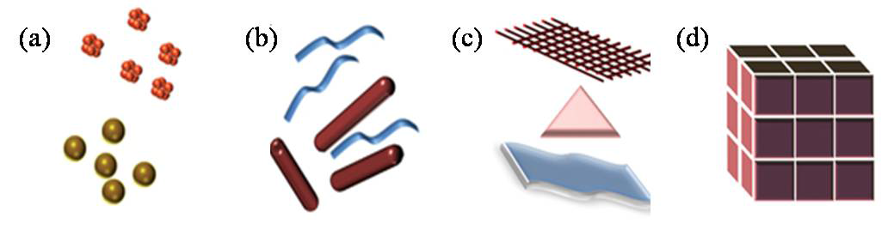
Zero dimension (quantum dots)
One dimension (quantum wires, rods)
Two dimension (plates, network, quantum wells)
Three dimension (fullerenes- C60, haeckelites)
Classification of Nanomaterials (a) 0D spheres and clusters, (b) 1D nanofibers, wires, and rods, (c) 2D films, plates, and networks, (d) 3D nanomaterials.

Slide 14
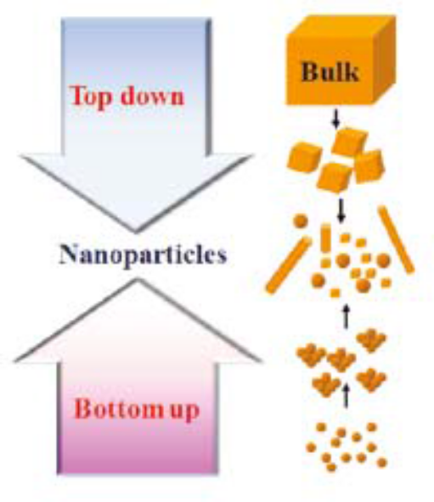
Nanomaterial - synthesis and processing
Nanomaterials deal with very fine structures: a nanometer is a billionth of a meter. This indeed allows us to think in both the ‘bottom up’ or the ‘top down’ approaches to synthesize nanomaterials, i.e. either to assemble atoms together or to dis-assemble (break, or dissociate) bulk solids into finer pieces until they are constituted of only a few atoms.
This domain is a pure example of interdisciplinary work encompassing physics, chemistry, and engineering upto medicine.
Schematic illustration of the
preparative methods of nanoparticles.

Slide 15

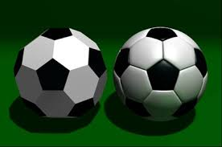
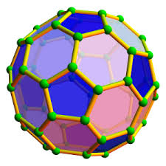
Fullerenes are spherical carbon-cage molecules with sixty (C60) or more carbon atoms. The molecule was named after R. Buckminster Fuller, who confirmed structural formula . A hollow pure carbon molecule in which atom lies at the vertices of polyhedron with 12 pentagonal faces and any number of hexagonal faces.
Each carbon is bound to other three carbon in pseudo spherical arrangement of alternating pentagonal and hexagonal rings in the manner of soccer ball . Hence the nick name Bucky ball. They measure about 0.7-1.5 nm in diameter. They are fascinating for scientists because they show unusual properties for carbon materials. Fullerenes are studied for potential medical use: they are strong antioxidants; one could also bind specific antibiotics to the structure to target resistant bacteria and even target certain cancer cells such as melanoma. Heat resistance and superconductivity are some of the more heavily studied properties of fullerenes in mechanical engineering.

Slide 16

Quantum dot:
Quantum dots are tiny semiconductot crystal, this means this particle can either conduct or resist depending upon temperature and purity of lab. There size ranges between 2-10nm. Because of small size they are governed bu quantum mecchanics. The size, energy level and emission colour of quantum dot can be precisely controlled hence they are extremely useful in variety of application. One of the unique property of quantum dots is their emission colour depend upon their size not the materials. The bigger the quantum dot bigger will be the wavelength and smaller the frequency it will emit. This means larger quantum dot will emit red light and smaller will emit blue.

Slide 17
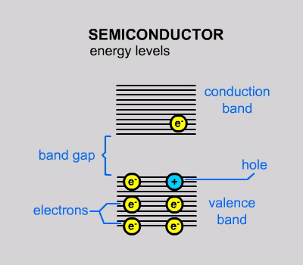

The average distance between an electron and a hole in a exciton is called the Excited Bohr Radius.When the size of the semiconductor falls below the Bohr Radius, the semiconductor is called a quantum dot.
Quantum dots can be prepared by variious ways but they are generally by chemical synthesis methods. Many different semiconductor can be used to prepare quantum dots such as cadmium selenide, cadmium sulphide, indium arsenide etc. The unique property of quantum dots are useful in medical imaging, energy efficient lighting displays and photovoltaic cell

Slide 18

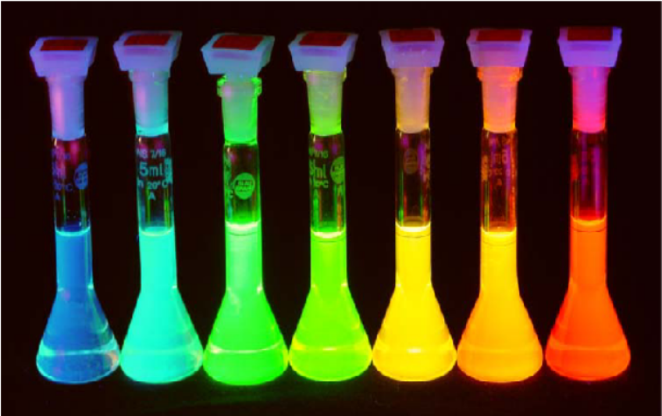
By changing size, shape, and composition, quantum dots can change their absorptive and emissive properties dramatically

Slide 19

Medicine-
Can be set to any arbitrary emission spectra to allow labeling and observation of detailed biological processes.
Quantum Dots can be useful tool for monitoring cancerous cells and providing a means to better understand its evolution.
In the future, Qdots could also be armed with tumor-fighting toxic therapies to provide the diagnosis and treatment of cancer.
Qdots are much more resistant to degradation than other optical imaging probes such as organic dyes, allowing them to track cell processes for longer periods of time.
Quantum dots offer a wide broadband absorption spectrum while maintaining a distinct, static emission wavelength.
LED-
Used to produce inexpensive, industrial quality white light.
Marked improvement over traditional LED–phosphor integration by dot’s ability to absorb and emit at any desired wavelength.
Produce white light by intermixing red, green, and blue emitting dots homogenously within the phosphor difficult to accomplish with the traditional LED-phosphor set up.

Slide 20

Traditional solar cells are made of semi-conductors and expensive to produce. Theoretical upper limit is 33% efficiency for conversion of sunlight to electricity for these cells.
Utilizing quantum dots allows realization of third-generation solar cells at ~60% efficiency in electricity production while being $100 or less per square meter of paneling necessary.
Effective due to quantum dots’ ability to preferentially absorb and emit radiation that results in optimal generation of electric current and voltage.
Other Future Quantum Dot Applications…
Anti-counterfeiting capabilities: inject dots into liquid mixtures, fabrics, polymer matrices, etc. Ability to specifically control absorption and emission spectra to produce unique validation signatures. Almost impossible to mimic with traditional semi-conductors.
Counter-espionage / Defense applications: Integrate quantum dots into dust that tracks enemies. Protection against friendly-fire events.
Research continues. The possibilities seem endless…

Slide 21

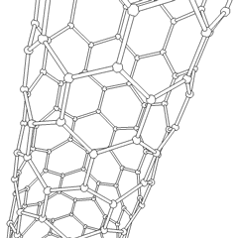
There name is derived from long hollow structure with wall formed by one atom thick sheets of carbon called graphene. These sheets are rolled at specific and discrete (chiral) angle. The combination of rolling angle and radius decides the nano tubes properties For e.g. Whether nano tube shell is metal or semi conductor.
They have outstanding mechanical and electronic properties and are good thermal conductors. The tensile strength, or breaking strain of CNTs is 6-7 times that of steel. They are among the stiffest and strongest fibers known. CNTs can be metallic or semiconducting depending on their structure. Some CNTs are the most efficient electrical conductors ever made, while others behave more like silicon. These properties, coupled with the lightness of carbon nanotubes, give them great potential for use in reinforced composites, nanoelectronics, sensors and nanomechanical devices.

Slide 22

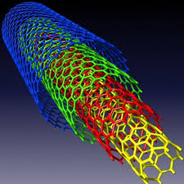
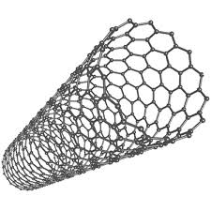
Carbon nano tubes are categorized as,
Single walled nano tubes (SWNT) Multi walled nano tubes (MWNT)
Nanotubes have been constructed with length-to-diameter ratio of up to 132,000,000 :1 significantly larger than for any other material. These cylindrical carbon molecules have unusual properties, which are valuable for nanotechnology, electronics, optics and other fields of materials science and technology

Slide 23
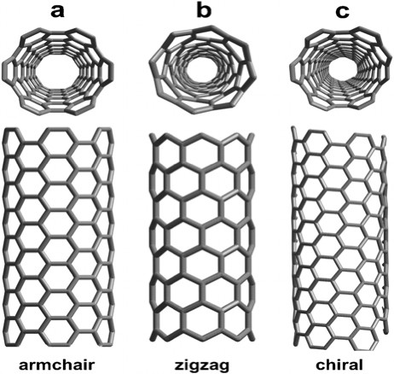
Single-walled
carbon nanotubes:
armchair - metallic
zigzag - semiconducting
chiral - semiconducting
multi-walled - metallic

Slide 24

Arc Method
Laser Method
Chemical deposition method

Slide 25

Electrical Conductivity
Strength and Elasticity
Thermal Conductivity
High aspect ratio and Field emission

Slide 26

The conductivity of CNT have been found to be function of their chirality, degree of twist as well as diameter. CNTs can be either metallic or semi conductor. The resistivity of single walled nanotubes ropes was of the order of 10⁻⁴ ohm-cm at 27°C. This means they are the most conductive carbon fiber known. The current density that was possible to achieve was 10⁹ A/cm² (while copper burn at 10⁶ A/cm² ) It has been reported that SWNT may contain some defects. This defects allow the SWNT to act as transistors, rectifying diodes. It has also been reported that single wall nanotubes can route electrical speed up to 10 GHz.

Slide 27

CNTs are expected to be ultimate high strength fiber. Single walled nanotubes are stiffer than steel and are resistant to damage from physical forces. Pressing on the tip of nanotubes will cause it to bend without damage to the tip. This property make CNTs very useful as probe tip for high resolution scanning probe microscopy.The current Young’s modulus value for single walled nanotubes is about 1 teraPascal but this value is highly disputed and a value as high as 1.8 TPa(tera Pascal)Young modulus depend on size and chirality of single walled nano tube.

Slide 28

CNTs have been shown to exhibit superconductivity below 20 °K. Preliminary experiments and simulation studies on thermal property of CNT show very high thermal conductivity. It is expected therefore nanotube reinforcement in polymeric materials may also significantly improve the thermal and thermo mechanical properties of composites. CNTs represent very high aspect ratio. The high aspect ratio means that lower loading of CNTs is needed than to other conductive material. CNTs have proven to be excellent additives to impart electric conductivity in plastics.

Slide 29

In Combat jackets, the CNTs are used as ultrastrong fibres.
They are also used in suspension bridges instead of steels.
They are used in the field of robotics, where large linear movement is often needed.
CNTs can be used to produce nanowires of other metals such as gold or zinc oxide.
CNTs are used as an ulternative to tungsten filaments in light bulbs.
MWCNTs coated with magnetite are used as magnets.
Nanotube membranes can be used for filtration of water.

Slide 30
CNTs have been shown to be superconducting at low temperature.
Nanotubes can be used as a biotech container.
CNTs have the potential to store between 4.2 to 65% hydrogen by weight.
The CNTs is often used as a vessel for transporting drugs into the body .

Slide 31

Information
Technology
Information
Technology
Information
Technology
Information
Technology
Information
Technology
Information
Technology
Information
Technology
Information
Technology
Information
Technology
Information
Technology
Information
Technology
Information
Technology
Mechanical Eng. &
Robotics
Mechanical Eng. &
Robotics
Mechanical Eng. &
Robotics
Mechanical Eng. &
Robotics
Mechanical Eng. &
Robotics
Mechanical Eng. &
Robotics
Mechanical Eng. &
Robotics
Mechanical Eng. &
Robotics
Mechanical Eng. &
Robotics
Mechanical Engineering /
Robotics
Biotechnology
Biotechnology
Biotechnology
Biotechnology
Biotechnology
Biotechnology
Biotechnology
Biotechnology
Transportation
Transportation
Transportation
Advance
Materials & Textiles
Advance
Materials & Textiles
Advance
Materials & Textiles
Advance
Materials & Textiles
Advance
Materials & Textiles
NANOTECHNOLOGY
NANOTECHNOLOGY
NANOTECHNOLOGY
NANOTECHNOLOGY
NANOTECHNOLOGY
NANOTECHNOLOGY
NANOTECHNOLOGY
NANOTECHNOLOGY
NANOTECHNOLOGY
NANOTECHNOLOGY
NANOTECHNOLOGY
NANOTECHNOLOGY
NANOTECHNOLOGY
NANOMATERIALS
National
Security &
Defense
National
Security &
Defense
National
Security &
Defense
National
Security &
Defense
National
Security &
Defense
National
Security &
Defense
Energy &
Environment
Energy &
Environment
Energy &
Environment
Energy &
Environment
Energy &
Environment
Energy &
Environment
Energy &
Environment
Energy &
Environment
Energy &
Environment
Food and
Agriculture
Food and
Agriculture
Food and
Agriculture
Food and
Agriculture
Food and
Agriculture
Food and
Agriculture
Food and
Agriculture
Food and
Agriculture
Food and
Agriculture
Food and
Agriculture
Food and
Agriculture
Food and
Agriculture
Food and
Agriculture
Food and
Agriculture
Medicine / Health
Food and
Agriculture
Aerospace

Slide 32
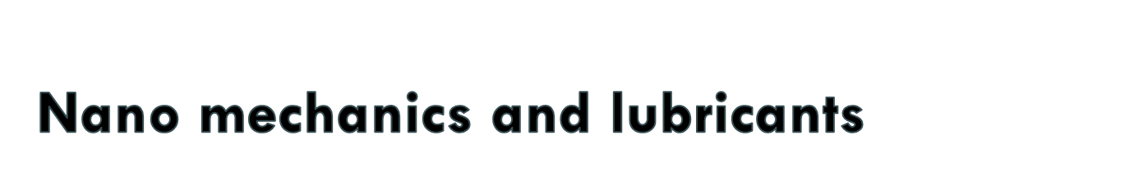
Carbon nanotubes are stiff and hard like diamond but flexible due to this they find several mechanical application. Cutting tools made up of Nano crystalline materials such as tungsten carbide titanium carbide are more wear resistant than convectional counter parts. They find application in drill, helmets, bullet proof cloth, etc. At present fastest known oscillators are made up of nanotubes. Nanotubes develop material which are slicker than Teflon and also waterproof. Membrane made up of CNTs allow liquid flow up to five times faster than conventional membrane.
Nano sphere of inorganic material can act as nano sized ball bearing. They also find application in high performance engine and drivers.

Slide 33

Nanomaterials are of the size 10⁻⁹. Hence the are smaller or comparable than single cell, virus, protein. Thus materials can freely move through tissue or bind to biological system. Endothelium layers are porous thus nano particle can penetrate through them and can be used as medicine or carrier. Many of magnetic nano particles have been used in cancer therapy like hyperthermia. Magnetic particle are also used for tagging cancer cells, bacteria red blood cells. They are also used in contrast enhancing agent in MRI. Thus they can used to detect brain tumor liver tumor and lymph nodes.

Slide 34
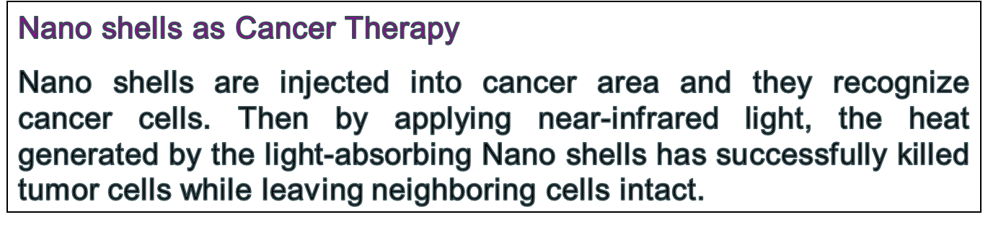
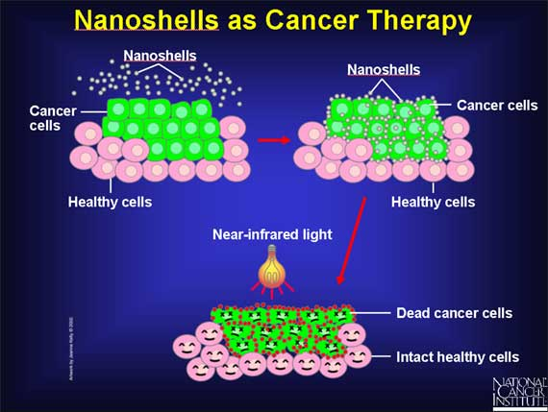

Slide 35

With nano technology it is possible to synthesize metal nano particles of highly ordered mono dispersed film. These nano catalyst greater activity and specific in action. It is possible to achieve specific or selective activity. This will reduce huge requirement of all rare earth metal in the production of catalyst
Nano porous aluminum silicates(zeolites) are used in water treatment. Nano porous membrane with definite and desired pore are used as nano filters for dust and impurities from air and water. Gold nano particles are used for degradation of toilet odor. Nano ZnO is used for degradation of chlorinated phenol. Nano photo catalyst are used for degradation of pollutant present in waste water.

Slide 36

Traditional electronic circuits are built by etching individual
components into silicon wafers. Rapid technological progress was first predicted in 1965 by Gordon Moore who stated that integrated circuit(IC) density and performance would double every 18 months. Electronic miniaturization has been the true driving force for nanotechnology research and applications. Nano electronics can help us to improve the capabilities of electronics devices while we reduce their weight and power consumption. Nanotechnologies are therefore expected to enable the production of smaller, cheaper devices with increasing efficiency. CNTs are being used for low voltage field emission displays. Nano crystalline nickel and metal hydrides are envisioned to require less frequent recharging and last longer. Nano scale fabricated magnetic material find application in data storage.

